Slide 1
DESIGNING THE NEW Smartphone keyboard
SET BY :DANIEL ASNAKEW

Slide 2
Smartphone keyboard
Definitions
Visibility
Feedback
Goal
Task
references

Slide 3
What Smartphone keyboard?
A Smartphone is a mobile phone with an advanced mobile operating system which combines features of a personal computer operating system with other features useful for mobile or handheld use.
a cellular phone that performs many of the functions of a computer, typically having a touch screen interface, Internet access, and an operating system capable of running downloaded applications.

Slide 4
keyboard
A keyboard is the set of typewriter-like keys that enables you to enter data into a Smartphone and other devices.
one that is designed to be used with wireless devices, such as personal digital assistants (PDAs) and smart phones.

Slide 5
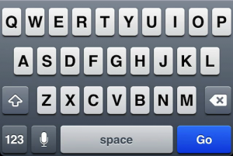
Visibility
The current system of smart phone keyboard
Visibility:-

Slide 6
Disadvantage of current Smartphone keyboard
All letter have similar in usage frequency of each letter.
Speed of key button to click
Usage Time
Portability
usability

Slide 7
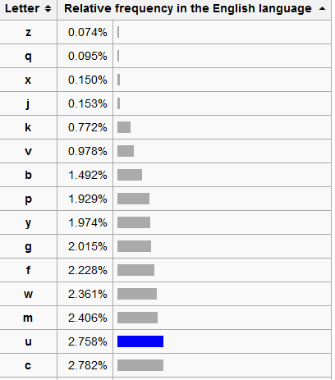
usage frequency of each letter.

Slide 8
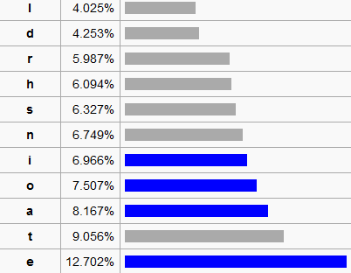
usage frequency of each letter.

Slide 9
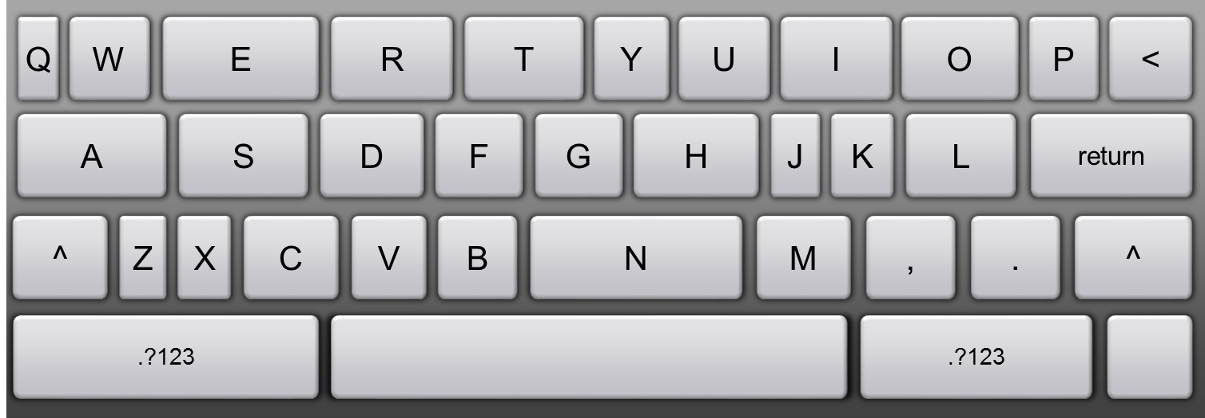
New Smartphone keyboard

Slide 10
Questions of Feedback
1).What is the limitation of new smart phone keyboard? Why?
2).Do you think the new smart phone keyboard to be implemented is easy to use? Why?
A) yes, definitely
B) not much difference with the old one
c) no, it has made further complexity

Slide 11
Questions of Feedback
3).do you think the new smart phone key bored to be implements is more efficient? Why?
A)yes
B) no
C)don’t see much difference regarding efficiency

Slide 12
Feedback
Mostly asked smart phone users
Some of the limitation of smart phone key board are:-
-number and letter arrangement
-symbol arrangement not based on the frequency
-number are not visible

Slide 13
Feedback
The keyboard easy to use definitely because of
- the letter very good arrangement
- the letter very visible to the user
- more attractive to use
-More portable for writing letter
The keyboard more efficient
-the general size of the keyboard minimized

Slide 14
Goal
Improve the key bored
Speed of key
Better time saving writing
Portability
Better learnability and adaptability for novice users.

Slide 15
Task
An action the user to do:
different button quickly click with short time
different button identify the position of the button
More portable for writing letter

Slide 16
References
http://scottbryce.com/cryptograms/index.htm
http://norvig.com/mayzner.html
www.scottbrvce.com
cryptograms
Oxford Dictionaries
images for usage frequency of each letter

